Slide 1
TNQ-Coderbyte assignment
Exploratory Data Analysis
On
World Population Dataset

Slide 2
EDA Inference
The dataset contains 234 rows and 17 columns
It contains the following columns
Index(['Rank', 'CCA3', 'Country', 'Capital', 'Continent', '2022_Population', '2020_Population', '2015_Population’, '2010_Population’, '2000_Population', '1990_Population', '1980_Population’, '1970_Population', 'Area(km²)', 'Density(per km²)', 'Growth_Rate’, 'World_Population_Percentage’], dtype='object’)
Categorical column names
Index(['CCA3', 'Country', 'Capital', 'Continent'], dtype='object’)
This dataset contains no missing values
Outliers are treated by replacing the values which are below 10% quantile and above 90%quantile

Slide 3
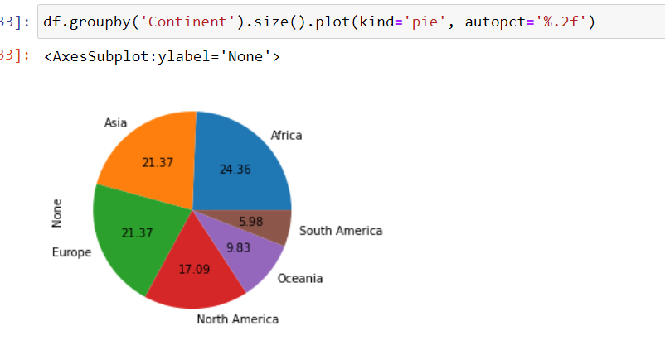
The size of each continent is shown below we can see that the count of Africa is the highest and the south America has the less records in our dataset

Slide 4
The given dataset contains multicollinearity problem that would destroy the model
In order to get rid of this problem we can remove the columns which contains high correlation within themselves.
The population in the years 2022,2020,2015,2010,2000 having almost same correlation we can remove the four columns.
Since the year 2022 contains high correlation with dependent variable that is world_population_percantage
we can use this column to train the model.
The population in the years 1990,1980,1970 having almost same correlation we can remove the any two columns.
Since the year 1990 contains high correlation with dependent variable that is world_population_percentage, we can use this column to train the model.

Slide 5
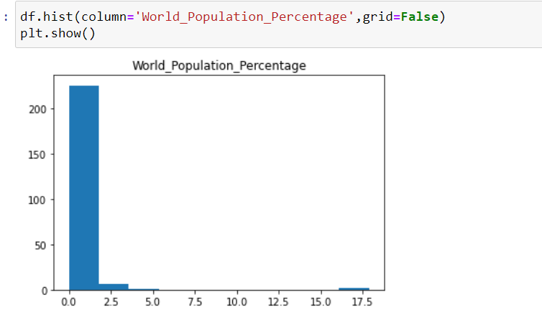
The world population percentage ranges from 0.0 to 17.88 but the maximum count of percentage ranges from 0.0 to 0.9

Slide 6
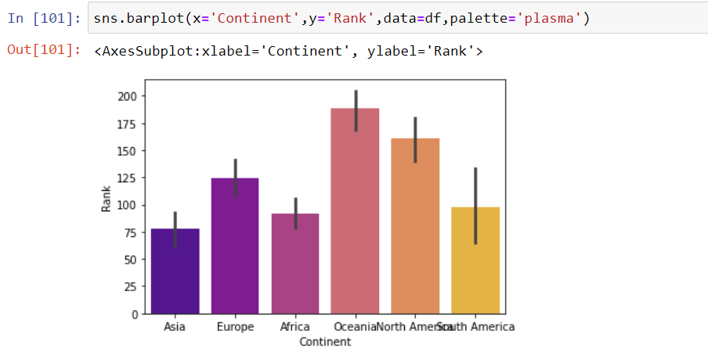
Oceania has the highest ranking followed by North America which lies around 150 to 180.
Asia has the least rank of 75.
Africa and South America almost have the same rank which was around 80.

